Slide 1
Algorithm Analysis (Big O)
Computer Science 3

Slide 2
Complexity
In examining algorithm efficiency, we must understand the idea of complexity
Space Complexity
Time Complexity

Slide 3
Space Complexity
When memory was expensive, and machines didn’t have much we focused on making programs as space efficient as possible and developed schemes to make memory appear larger than it really was (virtual memory and memory paging schemes)
Although not as important today space complexity is still important in the field of embedded computing (handheld computer-based equipment like cell phones, e-readers, etc.)

Slide 4
Time Complexity
Is the algorithm “fast enough” for my needs?
How much longer will the algorithm take if I increase the amount of data it must process to a very large number?
Given a set of algorithms that accomplish the same thing, which is the right one to choose?

Slide 5
Running Time of a Program
CPU
memory access
disk I/O access
time (clock cycles)

Slide 6
Cases to examine
Best case (Omega) - Ω(f(n))
if the algorithm is executed, the fewest number of instructions are executed
Average case (Theta) - θ(f(n))
executing the algorithm produces path lengths that will on average be the same
Worst case (Big-O) - O(f(n))
executing the algorithm produces path lengths that are always a maximum

Slide 7
Worst case analysis
Of the three cases the only real useful case (from the standpoint of program design) is that of the worst case
Worst case helps answer the software lifecycle issue of:
If its good enough today, will it be good enough tomorrow

Slide 8
Frequency Count
examine a piece of code and predict the number of instructions to be executed
Ex
for each instruction predict how many times each will be encountered as the code runs
Inst #
1
2
3
Code
for (int i=0; i< n ; i++)
{ cout << i;
p = p + i;
}
F.C.
n+1
n
n
____
3n+1
totaling the counts produces the F.C. (frequency count)

Slide 9
Order of magnitude
In the previous example best_case=avg_case=worst_case because the example was based just on fixed iteration
taken by itself, F.C. is relatively meaningless but expressed as an order of magnitude we can use it as an estimator of algorithm performance as we increase the amount of data
to convert F.C. to order of magnitude:
discard constant terms
disregard coefficients
pick the most significant term
the order of magnitude of 3n+1 becomes n
if F.C. is always calculated taking a worst case path through the algorithm the order of magnitude is called Big O (i.e. O(n))

Slide 10
Another example
Inst #
1
2
3
4
Code
for (int i=0; i< n ; i++)
for (int j=0 ; j < n; j++)
{ cout << i;
p = p + i;
}
F.C.
n+1
n(n+1)
n*n
n*n
____
F.C.
n+1
n²+n
n²
n²
____
3n²+2n+1
discarding constant terms produces : 3n²+2n
clearing coefficients : n²+n
picking the most significant term: n²
Big O = O(n²)

Slide 11
What is Big O
Big O is the rate at which performance of an algorithm degrades as a function of the amount of data it is asked to handle
For example: O(n) indicates that performance degrades at a linear rate; O(n²) indicates the rate of degradation follows a quadratic path.

Slide 12
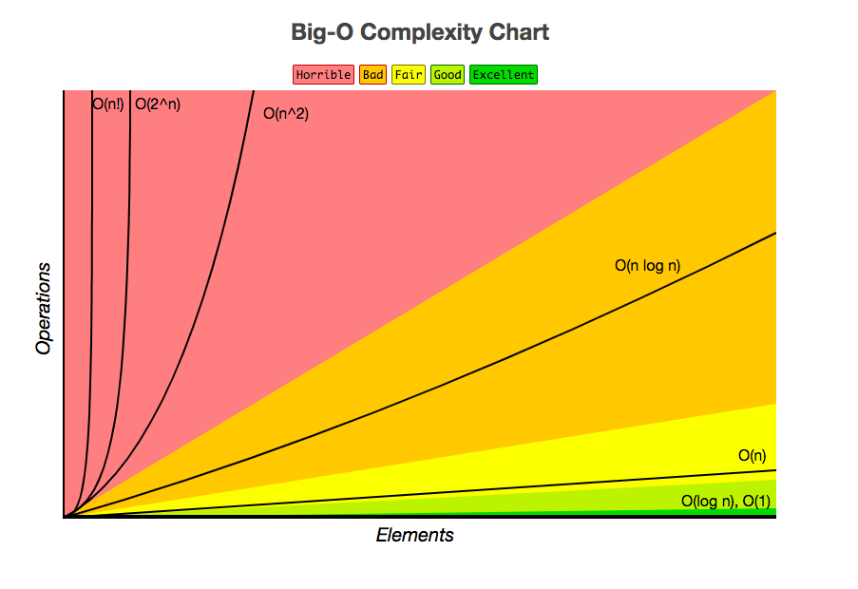
Common growth rates

Slide 13
A Few Comparisons
Function #1
n³ + 2n²
n^{0.1}
n + 100n^{0.1}
5n⁵
Function #2
100n² + 1000
log n
2n + 10 log n
n!

Slide 14
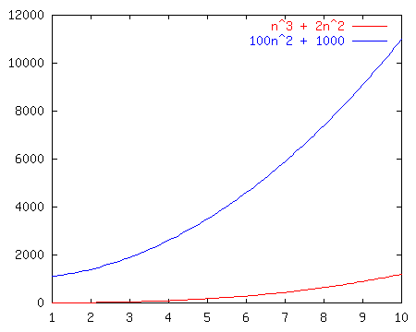
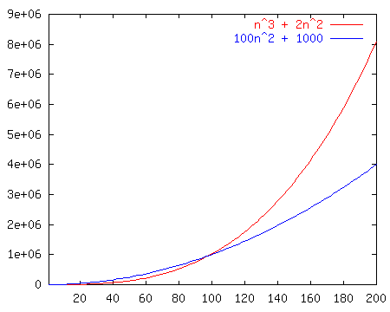
Race I
n³ + 2n²
vs.
100n² + 1000

Slide 15
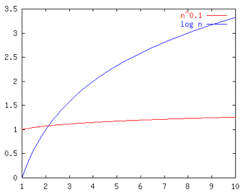
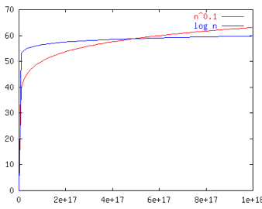
Race II
n^{0.1}
vs.
log n

Slide 16
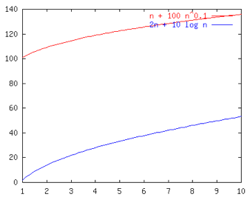
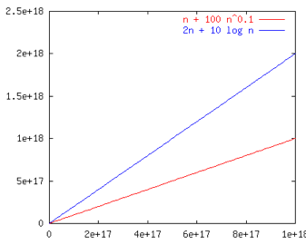
Race III
n + 100n^{0.1}
vs.
2n + 10 log n

Slide 17
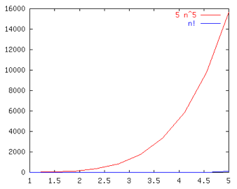
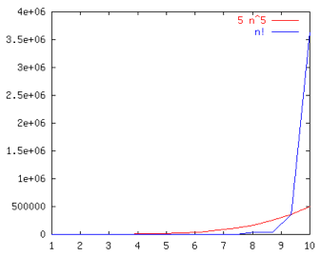
Race IV
5n⁵
vs.
n!

Slide 18
Race Results
Function #1
n³ + 2n²
n^{0.1}
n + 100n^{0.1}
5n⁵
Function #2
100n² + 1000
log n
2n + 10 log n
n!
Winner!
O(n²)
O(log n)
TIE O(n)
O(n⁵)

Slide 19
Common Names
constant: O(1)
logarithmic: O(log n)
linear: O(n)
log-linear: O(n log n)
superlinear: O(n^{1+c}) (c is a constant > 0)
quadratic: O(n²)
polynomial: O(n^{k}) (k is a constant)
exponential: O(c^{n}) (c is a constant > 1)
factorial: O(n!)

Slide 20
Comparing Data Structures
Data Structure Traverse Search
Unsorted ArrayList O(n) O(n)
Sorted ArrayList O(n) O(log n)*
Unsorted Array O(n) O(n)
Sorted Array O(n) O(log n)*
* Since it’s sorted you can use a binary search

Slide 21
Insertion
Inserting an element requires two steps:
Find the right location
Perform the instructions to insert
If the data structure in question is unsorted, then it is O(1)
Simply insert to the front
Simply insert to end in the case of an array
There is no work to find the right spot and only constant work to actually insert.

Slide 22
Comparing Data Structures
Data Structure Traverse Search Insert
Unsorted ArrayList O(n) O(n) O(1)
Sorted ArrayList O(n) O(log n)*
Unsorted Array O(n) O(n) O(1)
Sorted Array O(n) O(log n)*
* Since it’s sorted you can use a binary search

Slide 23
Insertion into an ArrayList/Array
Finding the right spot is O(log n)
Binary search on the element to insert
Performing the insertion
Shuffle the existing elements to make room for the new item

Slide 24
Shuffling Elements
5
12
35
77
101
Insert 29

Slide 25
Shuffling Elements
Worst case: inserting the smallest number
5
12
35
77
101
Would require moving N elements…
Thus shuffle is O(n)

Slide 26
Insertion into an ArrayList/Array
Finding the right spot is O(log n)
Performing the insertion (shuffle) is O(n)
Sequential steps, so add:
Total work is O(log n + n) = O(n)

Slide 27
Comparing Data Structures
Data Structure Traverse Search Insert
Unsorted ArrayList O(n) O(n) O(1)
Sorted ArrayList O(n) O(log n)* O(n)
Unsorted Array O(n) O(n) O(1)
Sorted Array O(n) O(log n)* O(n)
* Since it’s sorted you can use a binary search

